Slide 1
Architecture Design

Slide 2
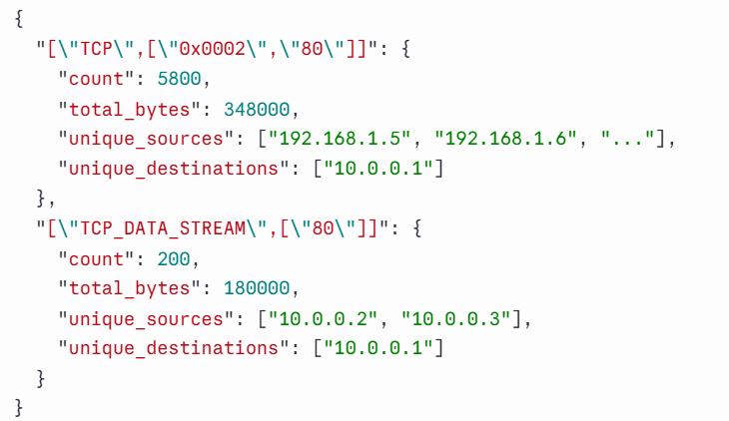
Preprocessor
Filter
tcp port 80 or tcp port 443
A SYN flood attack
Reducer
["TCP", ["0x0002", "80"]]
["TCP", ["0x0012", "80"]]
Previous Design:
    Goal:
      Reduce the PCAP size so it will fit an LLM budget
      Avoid feeding the pipeline with redundant packets
    Filter:
      Creates a BPF filter first using LLM
      Sees only the Attack Description as input (Letting the LLM peek at
      the PCAP would bias toward what the LLM expects to see).
    Reducer:
      Applies the filter on the PCAP
      Create fingerprints structured based on:
        Protocol (L2/L3/L4)
        Unique signals/flags
        DST ports and ips
      If the number of packets with same fingerprint is more than N:
        Keep N representative packets
        Fold the rest into aggregate stats
        Keep unique SRCs and DSTs
    Output:
      Reduced_representation,
      Stats: Compression_stats, Budget_status, Dropped_parse_failures_count, Fingerprint_index
PCAP
Reduced PCAP
Stats

Slide 3
Preprocessor
Filter
tcp port 80 or tcp port 443
A SYN flood attack
Reducer
["TCP", ["0x0002", "80"]]
["TCP", ["0x0012", "80"]]
Previous Design:
    Goal:
      Reduce the PCAP size so it will fit an LLM budget
      Avoid feeding the pipeline with redundant packets
    Filter:
      Creates a BPF filter first using LLM
      Sees only the Attack Description as input (Letting the LLM peek at
      the PCAP would bias toward what the LLM expects to see).
    Reducer:
      Applies the filter on the PCAP
      Create fingerprints structured based on:
        Protocol (L2/L3/L4)
        Unique signals/flags
        DST ports and ips
      If the number of packets with same fingerprint is more than N:
        Keep N representative packets
        Fold the rest into aggregate stats
        Keep unique SRCs and DSTs
    Output:
      Reduced_representation,
      Stats: Compression_stats, Budget_status, Dropped_parse_failures_count, Fingerprint_index
PCAP
Ambiguous Evidence: Picking individual Packets among many functionally-identical instances is hard to reproduce.
Reduced PCAP
Stats
Non-Deterministic Outputs: LLM producing syntax can create a different filter across runs – can’t evaluate
Reliability: If the description is ambiguous or the attack uses non-standard ports, the filter might be silently wrong.
Lost Data: Packets filtered before the reducer sees them leave zero trace
The LLM generates BPF syntax it cannot verify against the actual pcap.

Slide 4

Preprocessor
Updated Design:
    Goal:
      Create packet clusters based on similar traffic behaviors
      Avoid feeding the pipeline with redundant packets
    Output:
      Structured data structures of clusters with aggregated data
      Analysis of the clusters based on different scores and relevance
LAYER 0
LAYER 1
LAYER 2
LAYER 3
LAYER 4
Attack Context
Dissection
Fingerprint
Clustering
Analysis
LLM extracts intent into typed schema
L2→L3→L4→L7→Entropy per packet
L4 + L7 + entropy bucket + time bucket
Cluster class owns aggregate
TF-IDF · Z-scores · IP summary · Tiers

Slide 5
Layer 0 - AttackContext replaces the filter generator
Before — LLM generates BPF
AttackContext Schema
Free-text description → hard filter
Drops packets silently
suspected_protocols:
["TCP", "UDP", "ICMP", "ARP", "DNS", ...]
suspected_behaviors:
["flood", "unanswered_syn", "scanning", ...]
target_indicators:
["single_dst", "high_rate", "no_response", ...]
After — LLM extracts into schema
Free-text description → AttackContext
Intent extraction only, nothing is discarded before analysis
The AttackContext from Layer 0 is used for intent extraction, not filter creation
weight cluster relevance after analysis
"A SYN flood attack
targeting a web server"
suspected_protocols = ["TCP"]
suspected_behaviors = ["flood", "unanswered_syn"]
target_indicators = ["high_rate", "no_response", "single_dst"]
Notes:
The LLM's job changed from "write a BPF filter" to "classify this description into known categories". That's a task LLMs do reliably. The output is validated against an enum — any unknown value is silently dropped rather than causing a malformed filter.

Slide 6
Layers 1–2 – Analyzing Packets and Fingerprinting
Over Segmentation
(clusters too small)
Splitting packets that represent the same "idea" into the many clusters
For example:
if we include the source IP in the fingerprint, each unique attacker in a DDoS gets its own cluster - instead of one "flood" cluster you get thousands of singleton clusters.
Fingerprint key
L4 Protocol
Signature
L7 Protocol
DST PORT
Entropy bucket
Time bucket
Signature: protocol-specific structural state: TCP state machine output ("SYN", "SYN-ACK", "ACK_HANDSHAKE", "DATA", "FIN", "RST"), or for other protocols a composite like "ICMP:8:0", "ARP:2:aa:bb:cc"
Payload entropy (L7 only)
Temporal buckets
Better indication about legitimate payload and malicious, encrypted payload
LOW, MEDIUM, HIGH, VERY HIGH
time_bucket = ⌊timestamp / Δt⌋
Same attack, hours apart → different clusters
Same attack, same wave → same cluster
Δt tunable (default 300s)
Notes:
state_sig — protocol-specific structural state: TCP state machine output ("SYN", "SYN-ACK", "ACK_HANDSHAKE", "DATA", "FIN", "RST"), or for other protocols a composite like "ICMP:8:0", "ARP:2:aa:bb:cc"

Slide 7
Layers 1–2 – Analyzing Packets and Fingerprinting
Under Segmentation
(clusters too large)
Merging packets that represent different "ideas" into the same cluster.
For example:
without temporal bucketing, two separate SYN flood waves hours apart collapse into one cluster, hiding the fact that the attack had distinct phases.
Fingerprint key
L4 Protocol
Signature
L7 Protocol
DST PORT
Entropy bucket
Time bucket
Signature: protocol-specific structural state: TCP state machine output ("SYN", "SYN-ACK", "ACK_HANDSHAKE", "DATA", "FIN", "RST"), or for other protocols a composite like "ICMP:8:0", "ARP:2:aa:bb:cc"
Payload entropy (L7 only)
Temporal buckets
Better indication about legitimate payload and malicious, encrypted payload
LOW, MEDIUM, HIGH, VERY HIGH
time_bucket = ⌊timestamp / Δt⌋
Same attack, hours apart → different clusters
Same attack, same wave → same cluster
Δt tunable (default 300s)
Notes:
state_sig — protocol-specific structural state: TCP state machine output ("SYN", "SYN-ACK", "ACK_HANDSHAKE", "DATA", "FIN", "RST"), or for other protocols a composite like "ICMP:8:0", "ARP:2:aa:bb:cc"

Slide 8
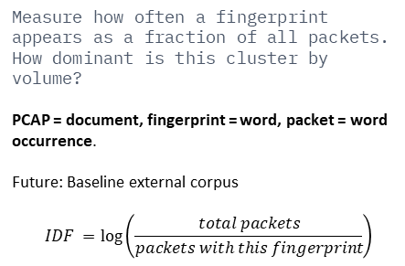
Layer 4 — Metadata Analysis
Relative Volume + TF-IDF weight
Per-protocol Z-scores
IP summary
Anomaly detection
Measure how often a fingerprint appears as a fraction of all packets.
How dominant is this cluster by volume?
PCAP = document, fingerprint = word, packet = word occurrence.
Future: Baseline external corpus
$$IDF =\log\left(\frac{total packets}{packets with this fingerprint}\right)$$
Is this cluster statistically unusual compared to other clusters of the same protocol?
For example, for all TCP clusters we compute packet rate for each, take the median and MAD, score each cluster by how far it deviates from that within-group baseline.
Per-IP structural profile: traffic volume, fanout cardinality, top fingerprints, anomaly involvement, timestamp-ordered sample packets.
Per-protocol cardinality fanout vs within-protocol median baseline. Mirrors evidence_matcher logic, now computed upstream where the full cluster context is available.
Context match
Tag Assignment
AttackContext.suspected_protocols cross-referenced against cluster L4/L7 proto.
For example, ICMP clusters score high in a ping flood, low in a SYN flood.
PRIMARY
SECONDARY
REMNANT
High TF-IDF or anomalous Z-score AND context match
Anomalous but moderate signal
Low TF-IDF, no anomalies, no context match
Notes:
IDF (inverse document frequency) = in a normal corpus this penalises common words ("the", "and"). In our single-pcap context we only have one document, so IDF is computed as log(number_of_clusters) — it's a constant that scales the score but doesn't differentiate between clusters the way it would in a multi-document corpus.
Z score problem - The limitation here is the same one we discussed earlier: if the pcap is entirely a SYN flood with no normal traffic, all TCP clusters look similar and nothing scores anomalous. The baseline is always relative to this pcap, not to some external "normal traffic" reference.

Slide 9
Preprocessor
Cluster
fingerprint_key
representative_items: list[ReducedItem]
aggregate: AggregateStats
metadata: ClusterMetadata
TCP SYN
SRC: 10.0.0.1
DST: 192.168.1.5
Port 53 Flags=0x02
TCP SYN
SRC: 10.0.0.2
DST: 192.168.1.5
Port 53 Flags=0x02
TCP SYN
SRC: 10.0.0.3
DST: 192.168.1.5
Port 53 Flags=0x02
UDP DNS
SRC: 10.0.0.9
DST: 192.168.1.5
Query:”google.com”
Entropy low
ARP
SRC: 10.0.0.9
DST: 192.168.1.1
Op=1 MAC:aa:bb:CC
TCP SYN
SRC: 10.0.0.4
DST: 192.168.1.5
Port 53 Flags=0x02
TCP SYNACK
SRC: 192.168.1.5
DST: 10.0.0.2
Port 53 Flags=0x12
SYN flood
ARP Request
Fingerprint: ["ARP", "ARP:1:aa:bb:cc", null, null, null, 0]
Legitimate DNS Query
Fingerprint: ["TCP", "SYN-ACK", null, 53, null, 0]
TCP SYN ACK
Fingerprint: ["TCP", "SYN-ACK", null, 53, null, 0]
Finger print: ["TCP", "SYN", null, 53, null, 0]
representative: #1, #2
aggregate: count = 4 (pkts #1,2,3,4) unique_srcs = 5 (10.0.0.1 → 10.0.0.4) unique_dsts = 1 (192.168.1.5)
IAT mean = 0.0008s
IAT std = 0.000001s
Count = 1
unique_srcs = 1 (10.0.0.9)
unique_dsts = 1 (192.168.1.1)
Count = 1
unique_srcs = 1 (10.0.0.9)
unique_dsts = 1 (192.168.1.5)
Count = 1
unique_srcs = 1 (192.168.1.5)
unique_dsts = 1 (10.0.0.2)

Slide 10
Preprocessor
Cluster
fingerprint_key
representative_items: list[ReducedItem]
aggregate: AggregateStats
metadata: ClusterMetadata
TCP SYN
SRC: 10.0.0.1
DST: 192.168.1.5
Port 53 Flags=0x02
TCP SYN
SRC: 10.0.0.2
DST: 192.168.1.5
Port 53 Flags=0x02
TCP SYN
SRC: 10.0.0.3
DST: 192.168.1.5
Port 53 Flags=0x02
UDP DNS
SRC: 10.0.0.9
DST: 192.168.1.5
Query:”google.com”
Entropy low
ARP
SRC: 10.0.0.9
DST: 192.168.1.1
Op=1 MAC:aa:bb:CC
TCP SYN
SRC: 10.0.0.4
DST: 192.168.1.5
Port 53 Flags=0x02
TCP SYNACK
SRC: 192.168.1.5
DST: 10.0.0.2
Port 53 Flags=0x12
SYN flood
ARP Request
Legitimate DNS Query
TCP SYN ACK
Primary
REMNANT
REMNANT
SECONDARY

Slide 11
Grounder: Follow up Changes
Before:
After:
Analyzed
Indicators
Grounding Dictionary
Reduced PCAP
LLM
Step x: Packets {#1, #3, #7}
Ranking Score
Cross - Encoder
[Step Description, Clusters]
Fitting Cluster(s) grounding the step
No Hallucinations: Deterministic similarity scoring replaces generative free-text parsing

Slide 12
Grounder: Follow up Changes
Before:
After:
Analyzed
Indicators
Grounding Dictionary
Reduced PCAP
LLM
Step x: Packets {#1, #3, #7}
Ranking Score
Cross - Encoder
[Step Description, Clusters]
Fitting Cluster(s) grounding the step
Error Detection& Reproducibility: Misclassification errors are easier to find than to track down if the model hallucinated an answer.

Slide 13
Grounder: Follow up Changes
Before:
After:
Analyzed
Indicators
Grounding Dictionary
Reduced PCAP
LLM
Step x: Packets {#1, #3, #7}
Ranking Score
Cross - Encoder
[Step Description, Clusters]
Fitting Cluster(s) grounding the step
Benchmarkable Performance: Enables standard ranking metrics for evaluation against tagged-dataset

